Slide 1
Camera calibration

Slide 2
References
http://szeliski.org/Book/
http://www.cs.cornell.edu/courses/cs5670/2019sp/lectures/lectures.html
http://www.cs.cmu.edu/~16385/

Slide 3
Camera intrinsics
Camera extinsics
Radial distortion

Slide 4
What is camera calibration
Geometric camera calibration, also referred to as camera resectioning, estimates the parameters of a lens, image sensor, position and view direction of a camera.
You can use these parameters to correct for lens distortion, measure the size of an object in world units, or determine the location of the camera in the scene. These tasks are used in applications such as machine vision to detect and measure objects. They are also used in robotics, for navigation systems, and 3-D scene reconstruction.
[from: https://www.mathworks.com/help/vision/ug/camera-calibration.html]

Slide 5
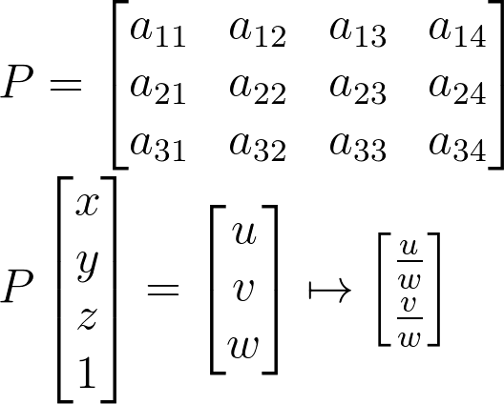
Starting from the end
The camera matrix is a full transformation from 3D objects in the scene to a 2D image with the specific camera parameters:
How many DOFs are we looking for?
Notes:
\\
P =
\begin{bmatrix}a_{11} & a_{12}&a_{13}&a_{14}
\\ a_{21}&a_{22} &a_{23}&a_{24}
\\a_{31}&a_{32}&a_{33}&a_{34}
\end{bmatrix}
\\
P
\begin{bmatrix}x
\\ y
\\z
\\1
\end{bmatrix}
=
\begin{bmatrix}u
\\ v
\\w
\end{bmatrix}
\mapsto
\begin{bmatrix}\frac{u}{w}
\\ \frac{v}{w}
\end{bmatrix}

Slide 6
Starting from the end
The camera matrix is a full transformation from 3D objects in the scene to a 2D image with the specific camera parameters:
How many DOFs are we looking for?
11, because in homogenous coordinates the answer is always correct up to a scale.
Notes:
\\
P =
\begin{bmatrix}a_{11} & a_{12}&a_{13}&a_{14}
\\ a_{21}&a_{22} &a_{23}&a_{24}
\\a_{31}&a_{32}&a_{33}&a_{34}
\end{bmatrix}
\\
P
\begin{bmatrix}x
\\ y
\\z
\\1
\end{bmatrix}
=
\begin{bmatrix}u
\\ v
\\w
\end{bmatrix}
\mapsto
\begin{bmatrix}\frac{u}{w}
\\ \frac{v}{w}
\end{bmatrix}

Slide 7
Starting from the end
Notes:
P_{3X4} = K_{3X3}[I|0]_{3X4}\Pi_{4X4}

Slide 8



Recap: perspective projection
Perspective projection (also known as perspective transformation) is a linear projection where three dimensional objects are projected on the image plane.
image plane
camera center
principal axis
Notes:
\begin{bmatrix}x
\\ y
\\ z
\end{bmatrix}
\begin{bmatrix}u
\\ v
\end{bmatrix}

Slide 9
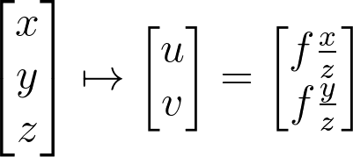
Recap: perspective projection
Using triangle proportions (Thales’ theorem) we can easily conclude that:
image plane
Notes:
\begin{bmatrix}x
\\ y
\\ z
\end{bmatrix}
\mapsto
\begin{bmatrix}u
\\ v
\end{bmatrix}
=
\begin{bmatrix}f\frac{x}{z}
\\ f\frac{y}{z}
\end{bmatrix}

Slide 10
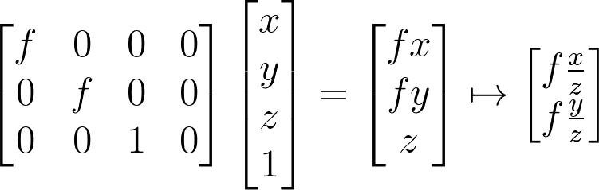

Recap: perspective projection
Let’s use the homogeneous coordinates:
Units of $[m]$
Notes:
\begin{bmatrix}f & 0&0&0
\\ 0&f &0&0
\\0&0&1&0
\end{bmatrix}
\begin{bmatrix}x
\\ y
\\z
\\1
\end{bmatrix}
=
\begin{bmatrix}fx
\\ fy
\\z
\end{bmatrix}
\mapsto
\begin{bmatrix}f\frac{x}{z}
\\ f\frac{y}{z}
\end{bmatrix}

Slide 11
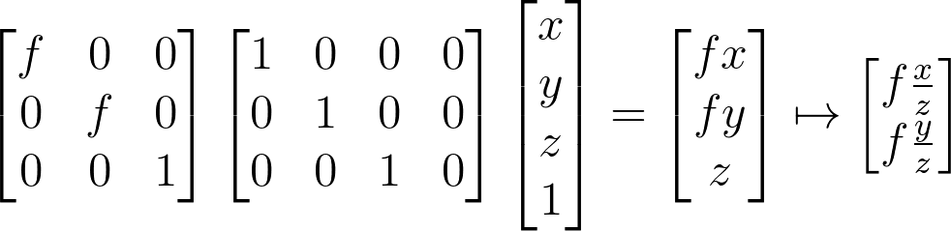
Recap: perspective projection
Let’s split into 2 matrices and use 3D->2D homogenous coordinates:
Intrinsic camera matrix
Projection matrix
Notes:
\begin{bmatrix}f & 0&0
\\ 0&f &0
\\0&0&1
\end{bmatrix}
\begin{bmatrix}1 & 0&0&0
\\ 0&1 &0&0
\\0&0&1&0
\end{bmatrix}
\begin{bmatrix}x
\\ y
\\z
\\1
\end{bmatrix}
=
\begin{bmatrix}fx
\\ fy
\\z
\end{bmatrix}
\mapsto
\begin{bmatrix}f\frac{x}{z}
\\ f\frac{y}{z}
\end{bmatrix}

Slide 12

Intrinsic camera matrix
The intrinsic matrix $K$ contains 5 intrinsic parameters. These parameters encompass
Scaled x & y focal length, image sensor format, and principal point.

Slide 13
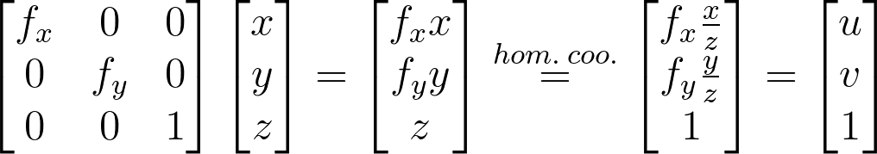

Intrinsic calibration matrix
Transforming to units of pixels in image space:
Pixel size in x dimension is $m_{x}$ and Pixel size in y dimension is $m_{y}.$
$$f_{x}=\frac{f}{m_{x}} \&{ f}_{y}=\frac{f}{m_{y}}$$
Notes:
\begin{bmatrix}f_x & 0&0
\\ 0&f_y &0
\\0&0&1
\end{bmatrix}
\begin{bmatrix}x
\\ y
\\z
\end{bmatrix}
=
\begin{bmatrix}f_xx
\\ f_yy
\\z
\end{bmatrix}
\stackrel{hom.\: coo.}{=}
\begin{bmatrix}f_x\frac{x}{z}
\\ f_y\frac{y}{z}
\\1
\end{bmatrix}
=
\begin{bmatrix}u
\\ v
\\1
\end{bmatrix}

Slide 15
Generalizing the camera matrix
In particular, the camera origin and image origin may be different:
image plane
camera coordinate system
image coordinate system

Slide 16
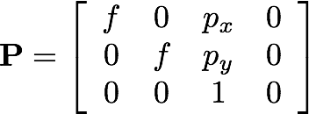
Generalizing the camera matrix
In particular, the camera origin and image origin may be different:
image plane
camera coordinate system
shift vector transforming camera origin to image origin
image coordinate system
How does the camera matrix change?

Slide 17
http://www.vision.caltech.edu/bouguetj/calib_doc/htmls/example.html
https://docs.opencv.org/2.4/doc/tutorials/calib3d/camera_calibration/camera_calibration.html
https://webcourse.cs.technion.ac.il/236873/Winter2017-2018/ho/WCFiles/Camera%20Calibration.pdf
http://ksimek.github.io/2012/08/13/introduction/

